Slide 1
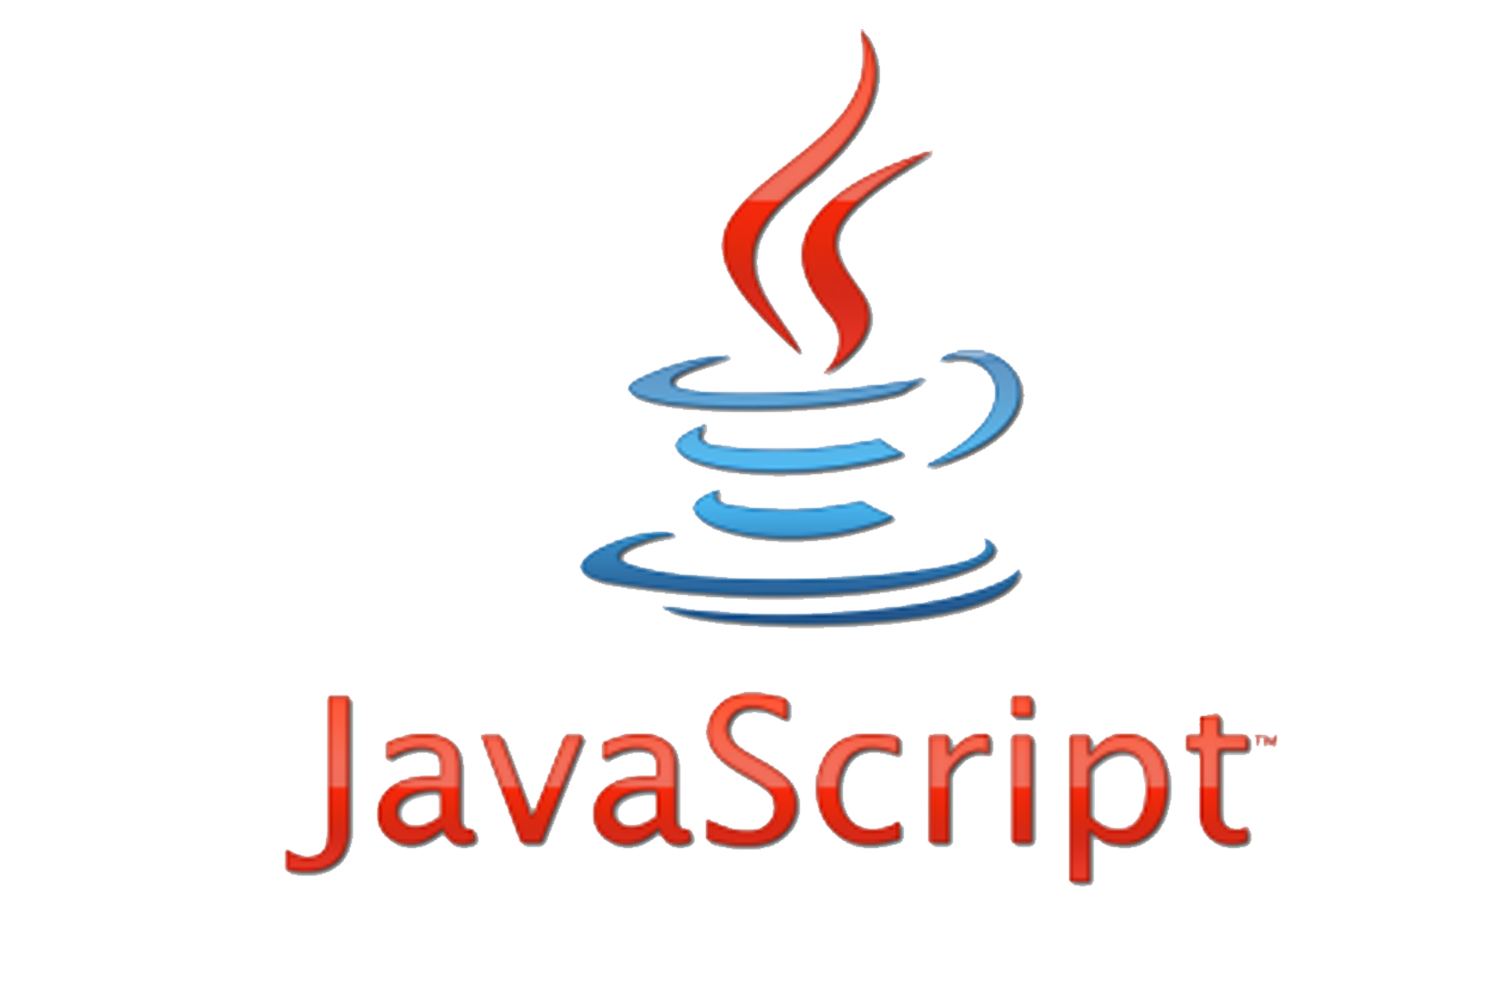

Slide 2
JavaScript® (often shortened to JS) is a lightweight, interpreted, object-oriented language with first-class functions, and is best known as the scripting language for Web pages

Slide 3
Data Types
5 primary data types in JS :-
Numbers
Strings
Booleans
Null and Undefined

Slide 4
Variables
Syntax for declaration of a variable in JS:
//string variable
var name = “rusty”;
//number variable
var secretNumber = 68;
//Boolean variable
var isAdorable = true;
//Undefined variable
var name;
//Null variable
var score = null;

Slide 5
SOME Methods in JS:
alert(“page opened”);
console.log(“Hi from the console”);
prompt(“what is your name?”);
//asks user a value that can be saved in a variable , eg.
var username = prompt(“user name ?”);

Slide 6
Arrays in JS:
Declaration:-
var friends = [ ];
var friends =[‘rohan’,’john’,’jolly’];

Slide 7
aRRAY METHODS IN JS
friends.push(“julie”);
//adds element to the end
friends.pop();
//deletes element from the end
friends.unshift(“julie”);
//adds element to the beginning
friends.shift();
//deletes element from the beginning.

Slide 8
Objects in JS:
Declaring a JS object:-
var objectName = {
attribute1:”someThing”,
attribute2:”someThing”,
---------------------------------,
---------------------------------,
attributeN:”someThing”,
};

